Slide 1
Synthetic Data
Deepak Nallamothu
24 February 2025

Slide 2
Agenda
1
2
3
4
5
Introduction
Primary Goals
&
Dataset Summary
Models
Evaluations
Summary

Slide 3
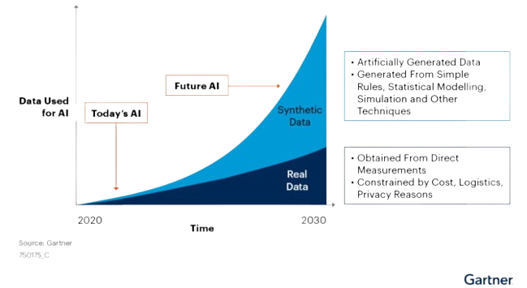
Introduction
What is Synthetic Data?
Synthetic data is essentially artificial data created algorithmically. It is designed to mimic the characteristics of real-world data without containing any actual information. Synthetic data enables models to be tested and improved without risking the privacy or security of real-world data. (Awan , 2023)
(Ramos & Subramanyam, 2021)

Slide 4
Primary goals
Generate synthetic data that mimics the actual data without revealing private information
Evaluate different models for generating synthetic data
Synthetic Data

Slide 5
DAA01 - Bovine Tuberculosis
STATISTIC | STATISTIC LABEL
DAA01C01 | Herds in County
DAA01C02 | Herds Tested
DAA01C03 | Herds Restricted since 1st of January
DAA01C04 | Herd Incidence
DAA01C05 | Herds Restricted by 31st of December
DAA01C06 | Animals in County
DAA01C07 | Tests on Animals
DAA01C08 | Reactors to date
DAA01C09 | Reactors per 1000 Tests A.P.T.
2010-2023 (Yearly)
29 Regional Veterinary Offices
406 Instances
Data type - Structured

Slide 6
Types of Generative Methodologies: GANs, VAEs, and Copulas
GANs (Generative Adversarial Networks)
VAEs (Variational Autoencoders)
Copulas
Best for: Categorical data, images, videos, and text data
How it works: Generator vs. Discriminator
Pros: Highly realistic data samples
Cons: Challenging to train
Best for: Numerical data, continuous data, and data with a clear structure
How it works: Encoder + Decoder
Pros: Probabilistic representation, dimensionality reduction
Cons: Difficulty in handling high-dimensional data
Best for: Multivariate data, complex dependencies, and non-linear relationships
How it works: Modelling joint distributions
Pros: Preserves dependencies, flexible modelling
Cons: Limited Flexibility

Slide 7
Selected Generative Models
CTGAN
TVAE
Gaussian Copula
Uses GANs methodology to generate synthetic tabular data Generates data that maintains the same statistical properties as the original data. Can handle mixed-type data (e.g., categorical and numerical)
Uses VAEs methodology to learn a probabilistic representation of tabular data. Can be used for data imputation, data augmentation, and anomaly detection Provides a flexible and interpretable way to model complex data distributions
A type of Copula model that assumes Gaussian marginals. Models the joint distribution of multiple variables using a Gaussian copula function. Can capture non-linear relationships and correlations between variables

Slide 8
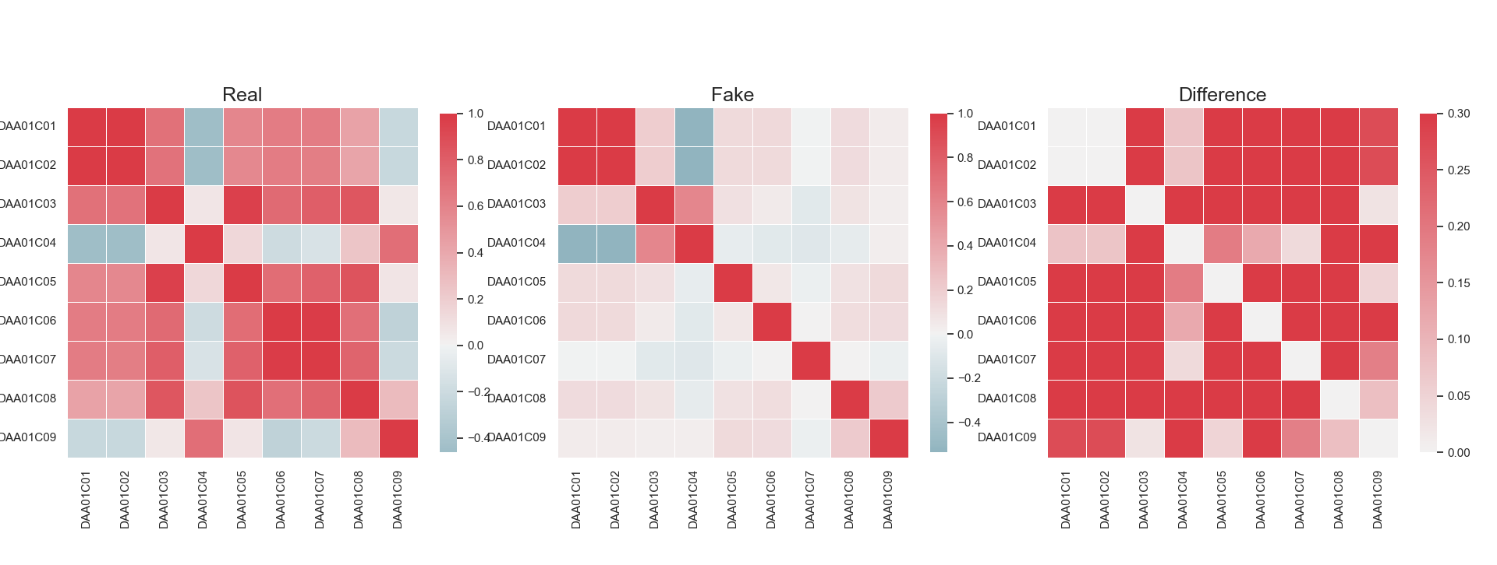
Correlation - CTGAN

Slide 9
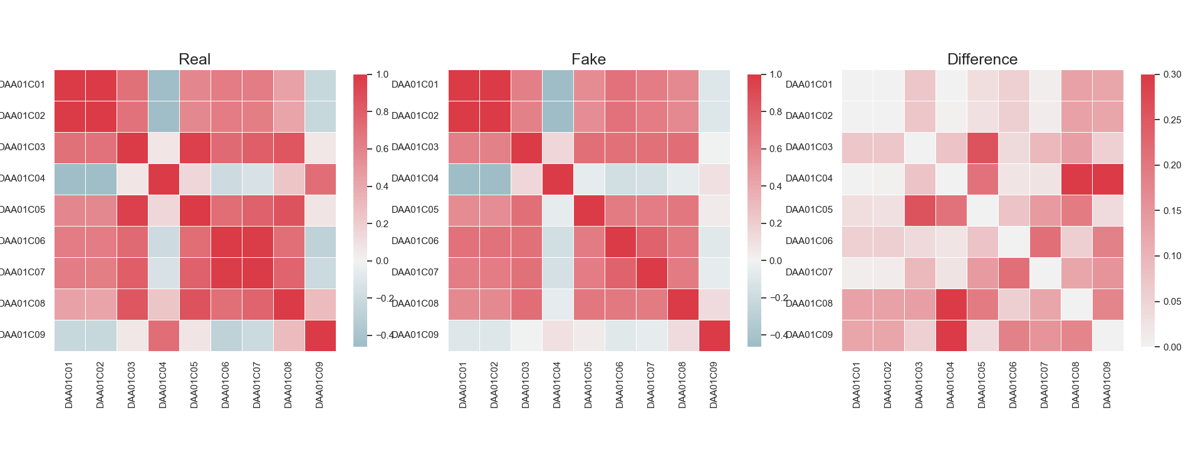
Correlation - TVAE

Slide 10
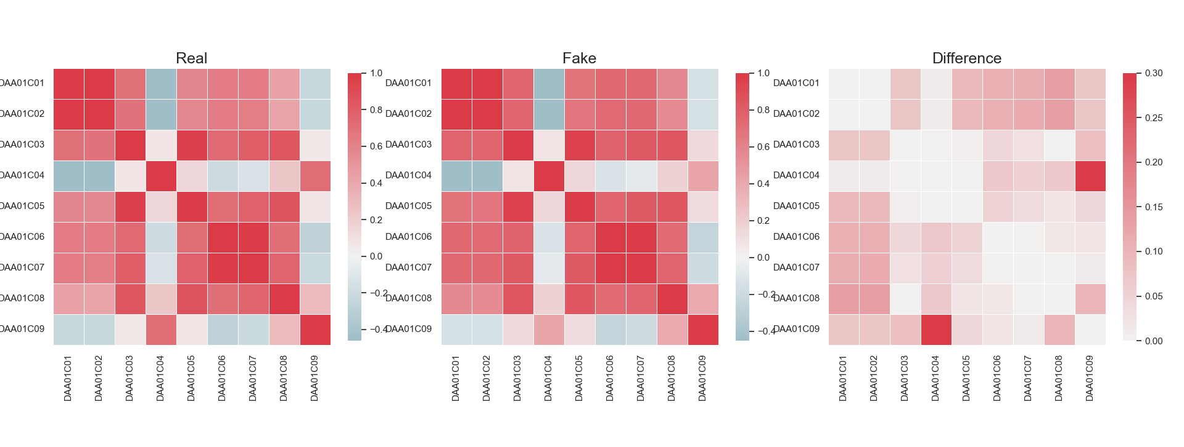
Correlation - GaussianCopula

Slide 11
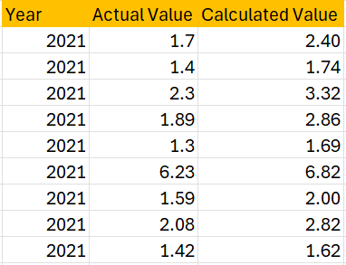
Data Inconsistency
STATISTIC | STATISTIC LABEL
DAA01C01 | Herds in County
DAA01C02 | Herds Tested
DAA01C03 | Herds Restricted since 1st of January
DAA01C04 | Herd Incidence
DAA01C05 | Herds Restricted by 31st of December
DAA01C06 | Animals in County
DAA01C07 | Tests on Animals
DAA01C08 | Reactors to date
DAA01C09 | Reactors per 1000 Tests A.P.T.
2019 – 2021
Incorrect calculations for DAA01C09

Slide 12
Data Quality
Values were generated using the built-in evaluation metric function of Synthetic Data Vault.

Slide 13
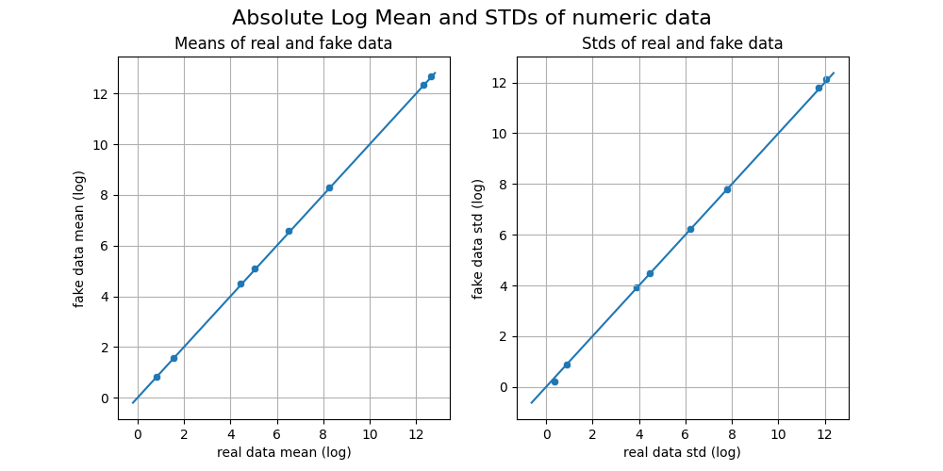
Gaussian Copula Absolute Log Mean And Standard Deviation

Slide 14
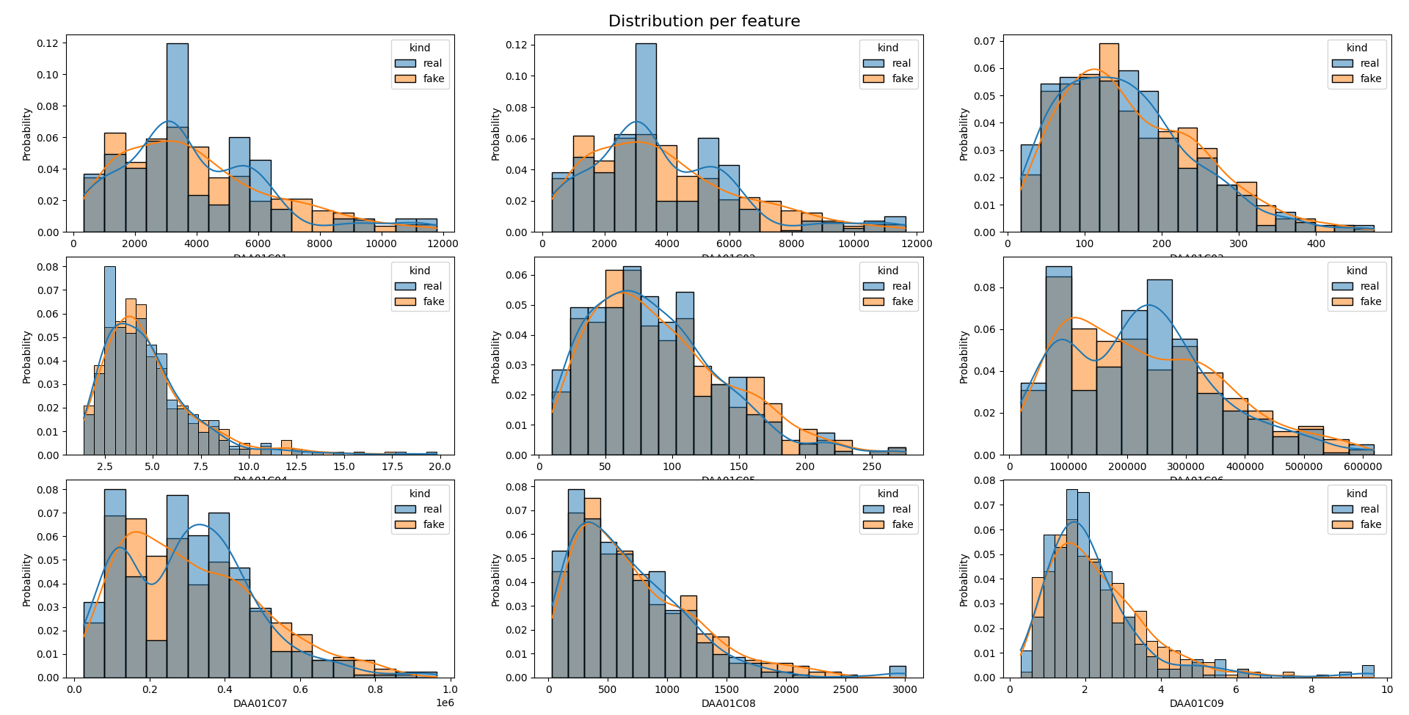
Gaussian Copula Distribution per feature

Slide 15
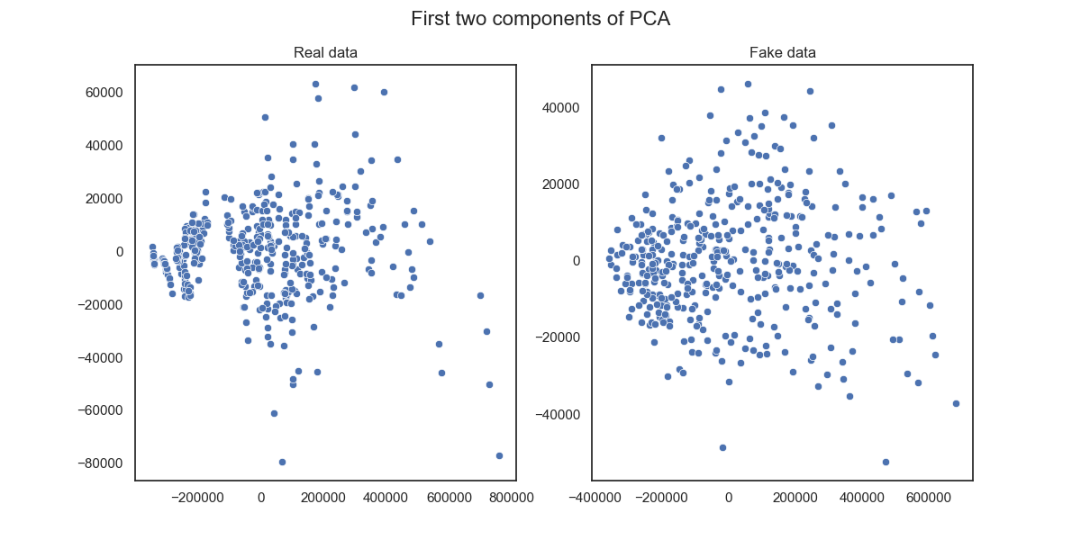
Gaussian Copula First two components of PCA

Slide 16
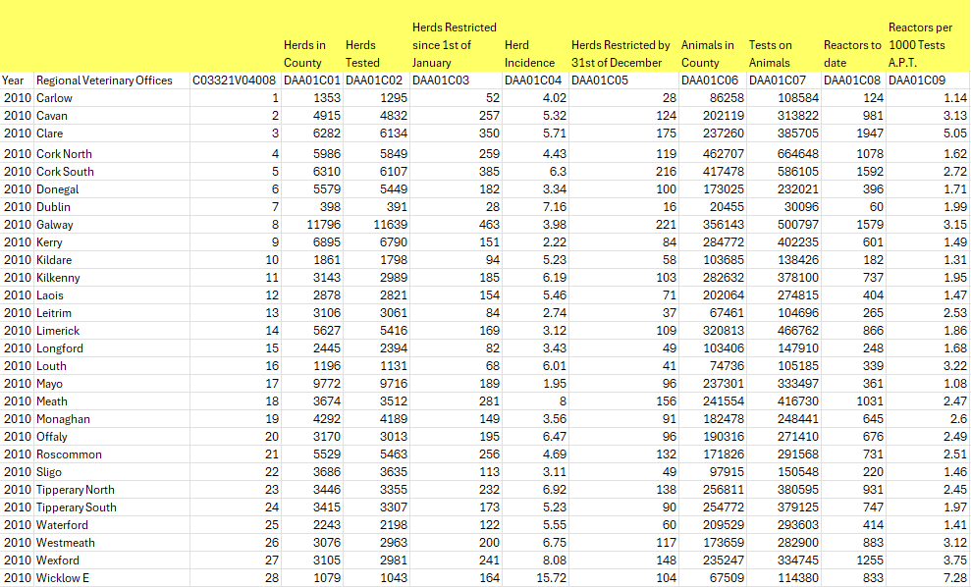
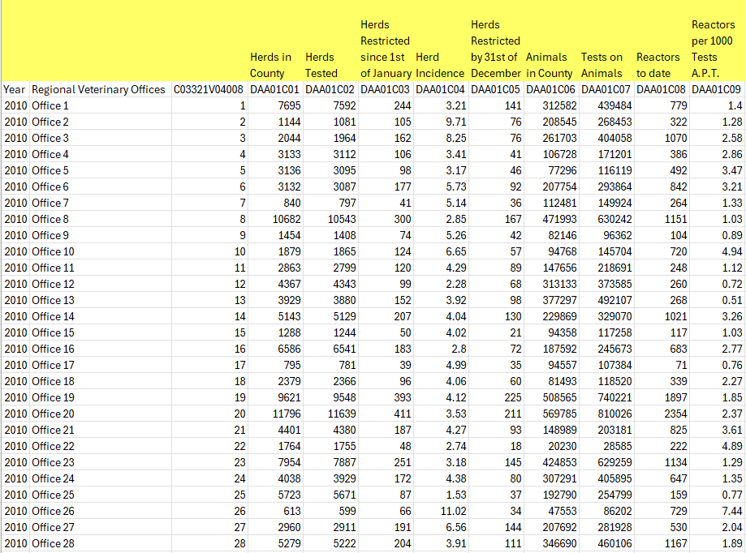
Datasets
Base Data
Synthetic Data (GaussianCopula)

Slide 17
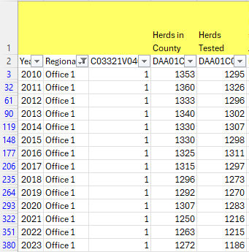
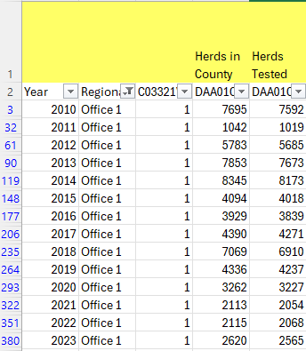
Limitation
The distribution of values for the same office across different years is not within the similar range.
Original Data
Synthetic Data (GaussianCopula)

Slide 18
Summary
Synthetic Data helps us achieve safe and effective AI development. By using different models, we can generate various types of synthetic data, such as tabular data, images, text, etc. Although the generated data may not be perfect, high-quality synthetic data can still serve as a suitable replacement for original data. The more we know about the original data, the better the synthetic data will be.

Slide 19
Further Steps

Slide 20
References
Awan, Abid Ali. "What Is Synthetic Data?" DataCamp, 6 July 2023, www.datacamp.com/blog/what-is-synthetic-data.
Ramos, L., & Subramanyam, J. (2021). Maverick Research: Forget About Your Real Data – Synthetic Data Is the Future of AI. Gartner.

